Slide 1


Governance
About
Locations
Find a Career
Sign In
A Shared Workspace Decentralized Autonomous Organization (DAO) with Incredible Employee Benefits Creating Meaningful Social Impact
Join the Community
Direct Business to Worker Model
Holistic costs reduced via WS0x Smart Contracts
Peer to Peer
Governed
As an employee, if you don’t like something, vote to change it
Socially
Responsible
Community voting system for social impact

Slide 2
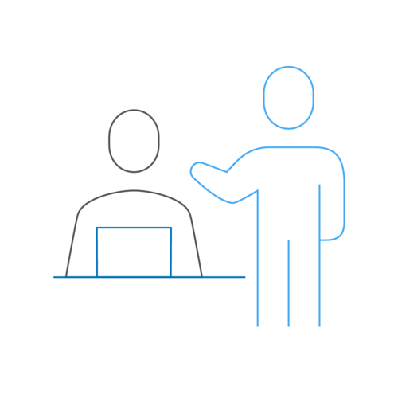
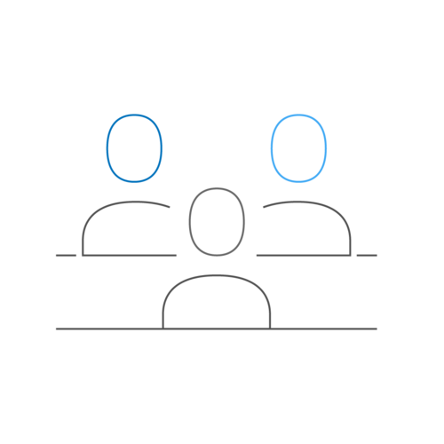
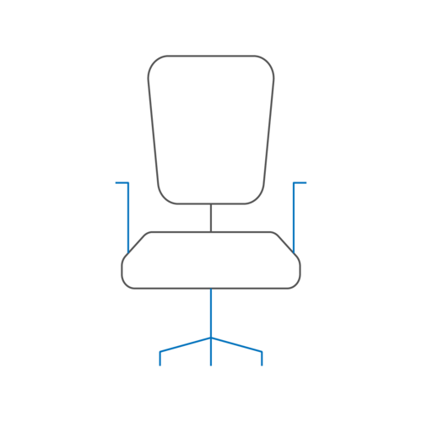
Governance
About
Locations
Find a Career
Sign In
Submit a Project
Join the Team
Businesses, find talent!
Talented? We Want You!
Workers
As the trend increases where traditional organizations are leaning more on free lancers, Workspace0x provides an opportunity to scale with stability
Supply Chain
As the community grows, employees benefit from the increased leverage for key services such as Medical Insurance, 401(k) and more
Workspaces
Workspaces can be physical or virtual in nature. The community votes and decides.

Slide 3
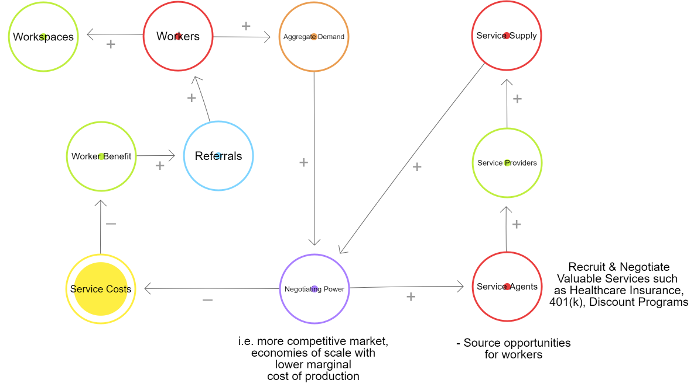
Governance
About
Locations
Find a Career
Sign In
Tokenization of the Ecosystem Creates Value
Link to Interactive Model

Slide 4
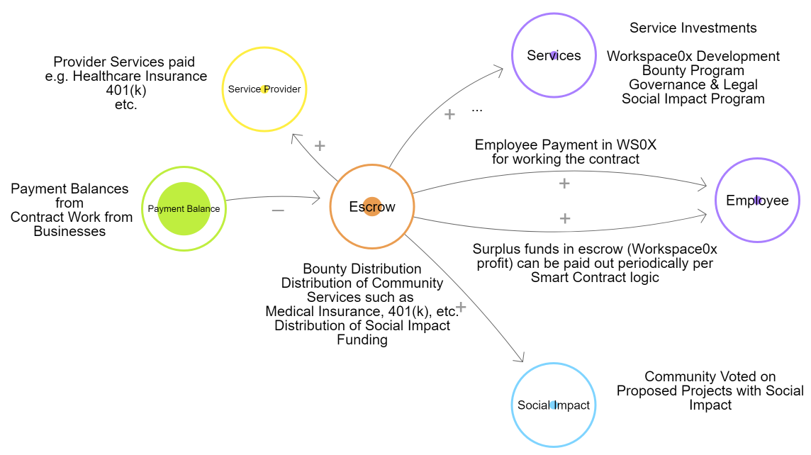
Governance
About
Locations
Find a Career
Sign In
State Flow Model
Link to Interactive Model

Slide 5


Governance
About
Locations
Find a Career
Sign In
Team
Michael Nolivos
Michael is passionate about using blockchain to create more valuable win-win Business 2 Worker models. He’s a strong Full-Stack developer.
William McGuire
William believes in using blockchain as a Force for Good. He believes Workspace0x will revolutionize the way companies are managed.
Betina Schnepf
Betina has a passion for research and a technical mind for the balance between on and off-chain architecture. She’s also an incredible Front-End Developer.

Slide 6
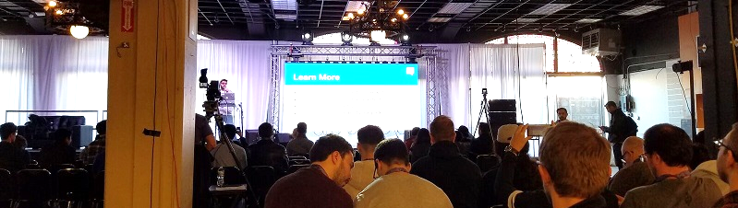
Governance
About
Locations
Find a Career
Sign In
The Workforce
Geographically Distributed
Latest statistics from the platform show the workforce is comprised of individuals all across the US from the East to West Coast.
Diverse Backgrounds
Full-Stack Developers, Blockchain Engineers, Project Managers, and UI/UX Designers are just a sample of the expertise the community has to offer your project
Continuous Innovators
The workforce is naturally inclined to pushing the envelope of technological innovation. To maximize value generation, the community voted governance protocol also monetarily incentivizes cross worker interaction and training.

Slide 7
Governance
About
Locations
Find a Career
Sign In
The Technology
Truffle
Open Zeppelin + Solidity
Vuex = Vue + Flux
Webpack
Bootstrap and jQuery
Javascript Framework
Authentication & Contract Payments
Device Independent & Responsive
HTML, CSS & Javascript bundler
UI/UX Aid
Notes:
Vuex is device independent

Slide 8
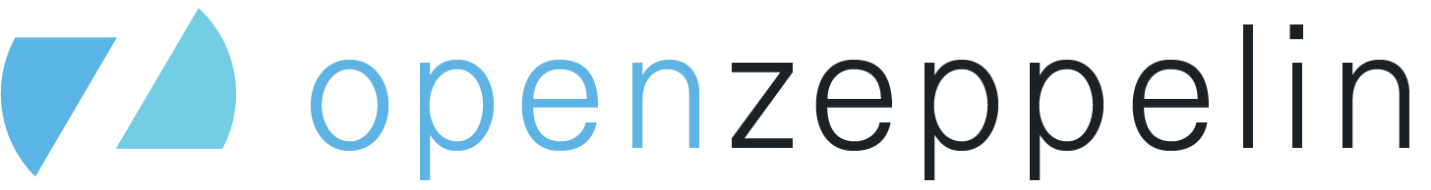

Governance
About
Locations
Find a Career
Sign In
Roadmap
Recruit Businesses
Improve Transaction Security
Expand Globally?
Form a Specialized Subsidiarity Workspace?
The Community Decides and Enforces the Organizational Change with Automated Governance Built on DLT
Minor Capital Raise
Community Genesis Needs
Talent | Education | Events
Incentivize Community Sharing
Employee Loans
Enable Employee Loans
Employs Loan Platform Money
Dharma

Slide 9
Theoretical
In theory, since it requires 51% majority to make Governance Changes, Organizational Agility could be reduced.
What reduction in organizational Agility of the DAO will be worth the potential reduction in fraud & value of the shared transparency of the network and the governing incentives which keep the trustless community, trustful?
Notes:
Vuex is device independent

